Slide 1


Advanced Models
Group 3

Slide 2
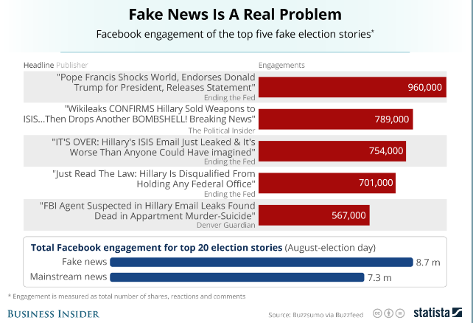
How viral are fake news?

Slide 3
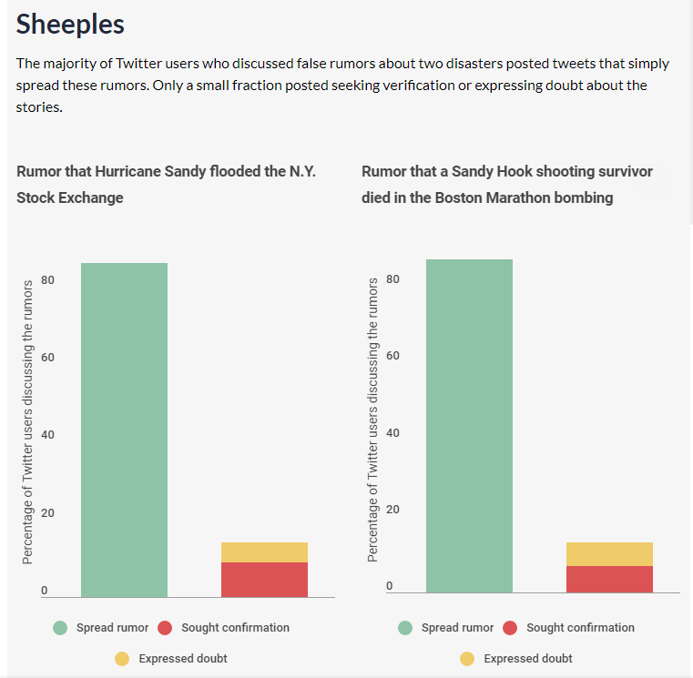
People don’t seek confirmation for stories

Slide 4
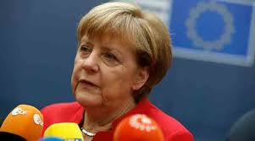
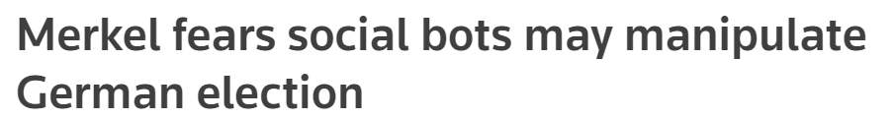

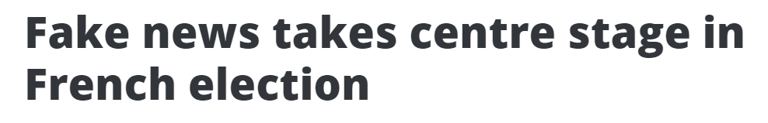
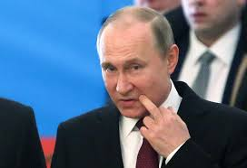
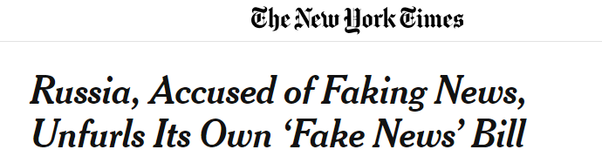

Slide 5
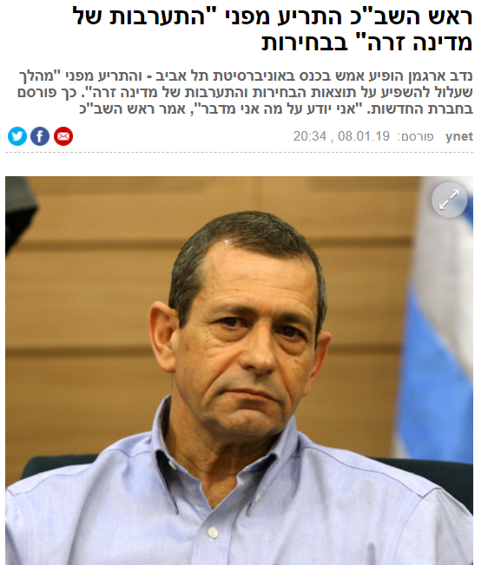
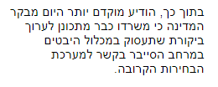
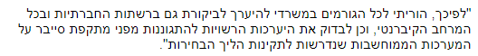

and soon to be seen again in our own back yard…

Slide 6
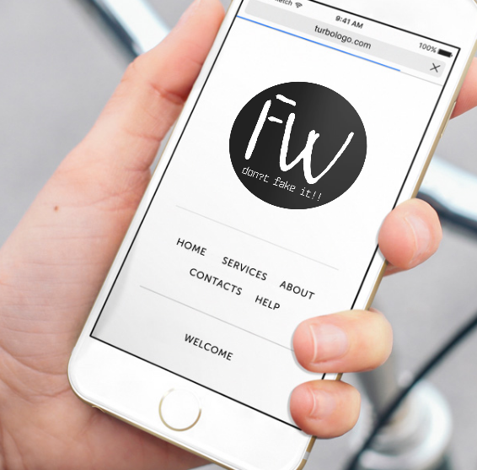
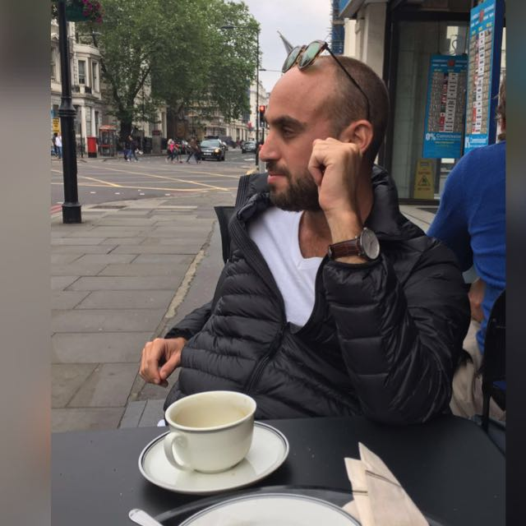
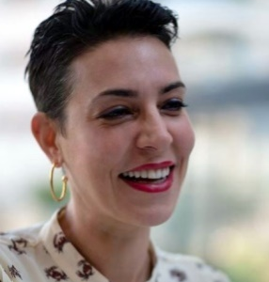
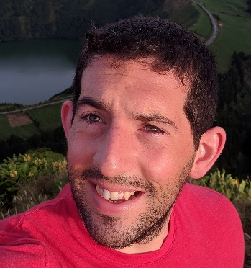
We are FakeWatch
Yoav Ast
CDO Product Manager
Yael Szafran CMO Planning and story telling
Omri Stayer CTO
Developer

Slide 7
Our vision
Detecting & Monitoring
Real-time Fake News
Protect society and businesses from harmful manipulation using machine learning algorithms

Slide 8

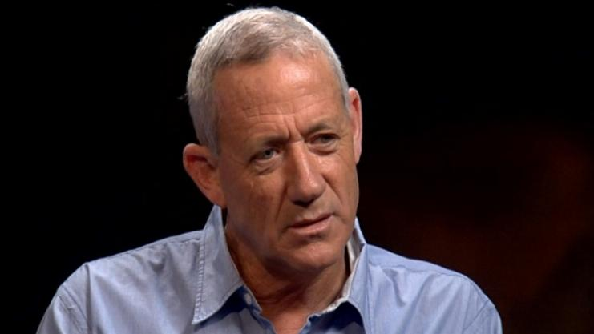
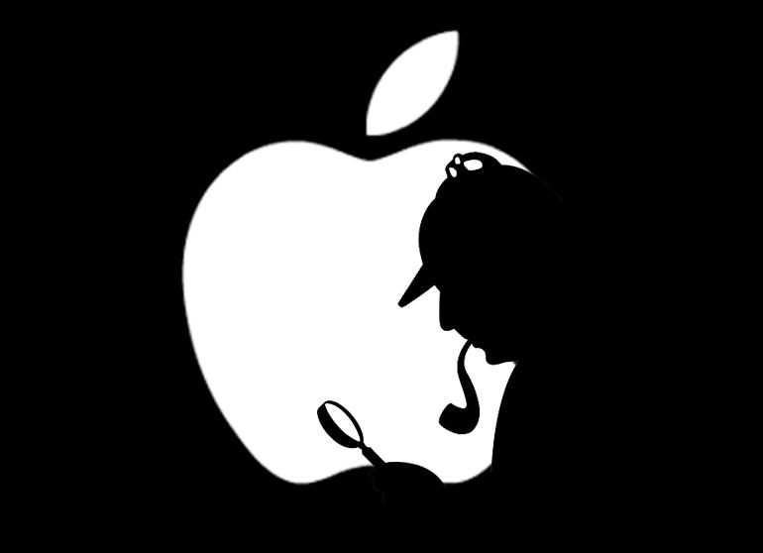
Our Focus
Chrome Extension– Fake detector, the FakeWatch Alarm
Fake News Targeted detection
Businesses
Individuals

Slide 9

Recall
Precision

Slide 10
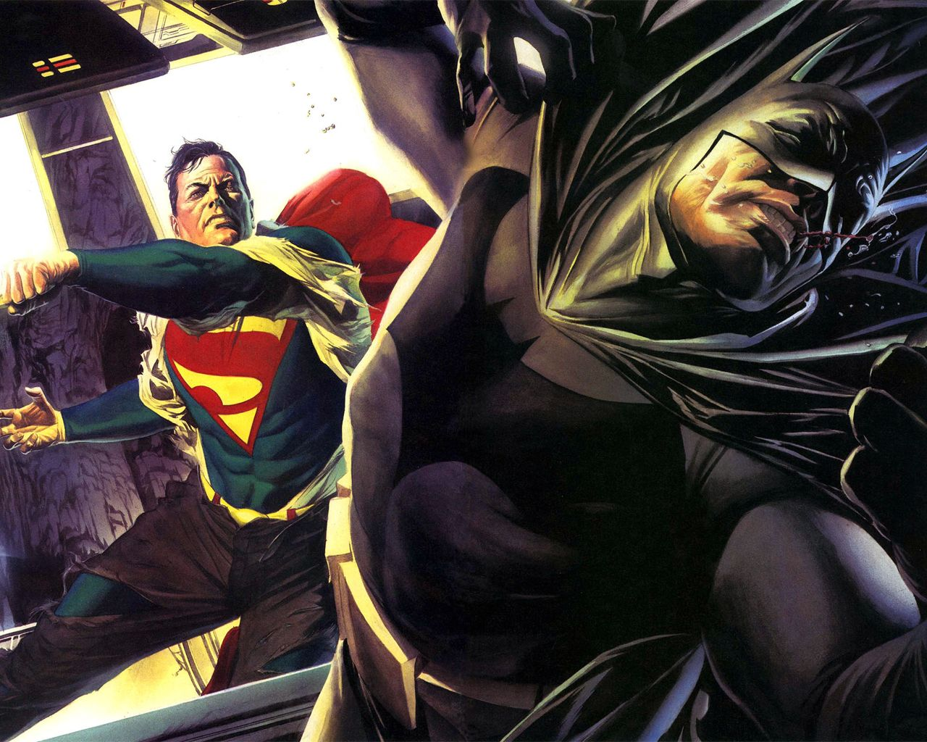
We aim to alert therefore seek high recall

Slide 11
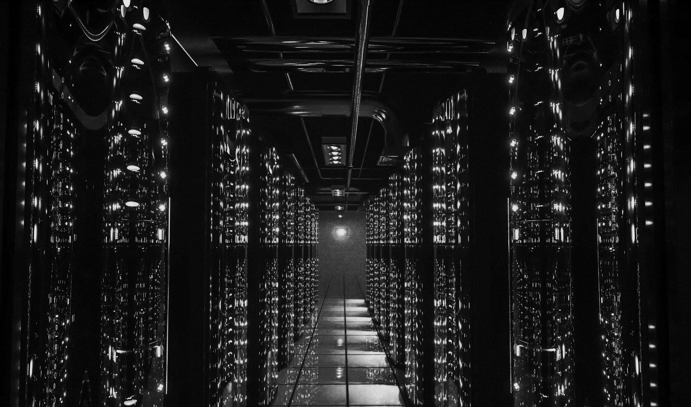
The Data

Slide 12
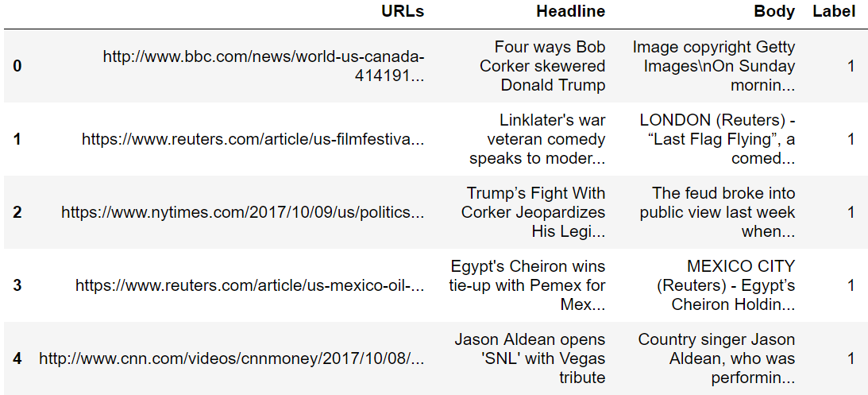

Slide 13
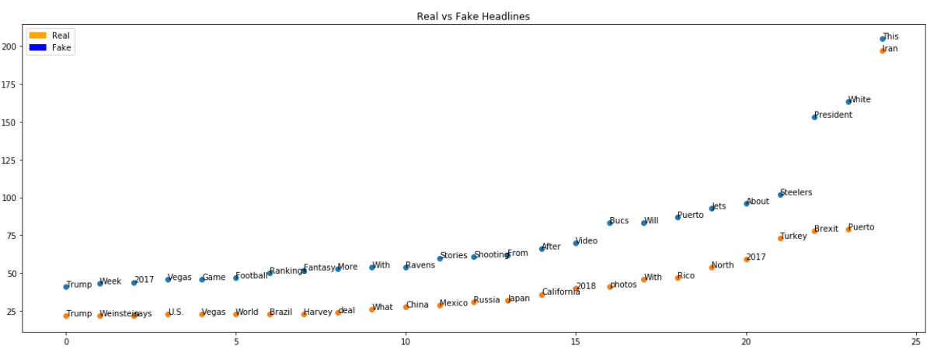

Slide 14
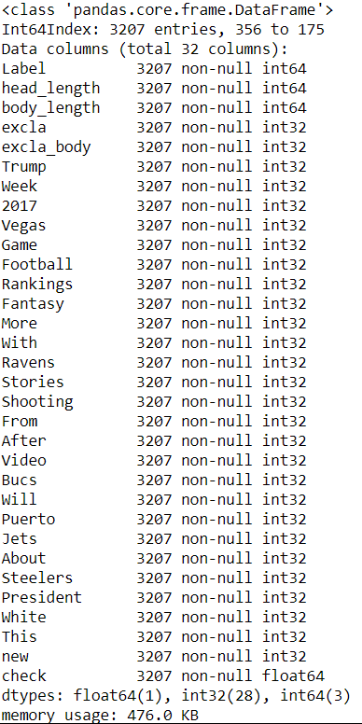
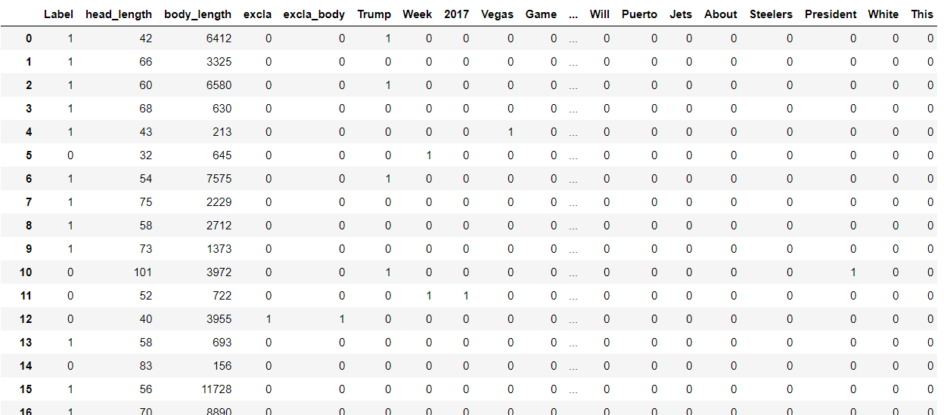

Slide 15
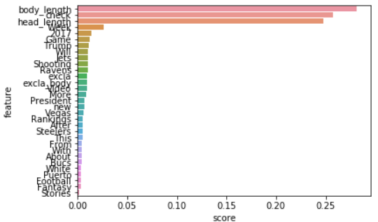
Features Scores

Slide 16
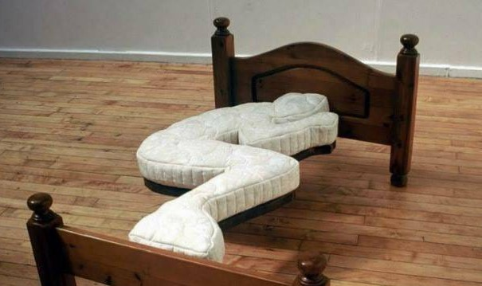
Overfitting

Slide 17
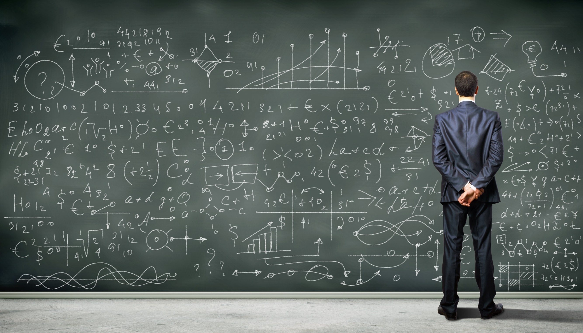

Slide 18
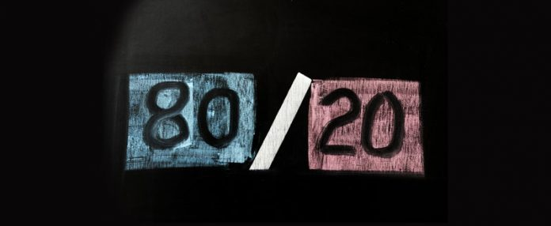

Slide 19

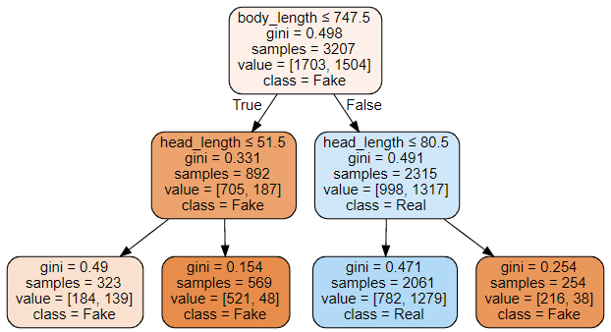
Small Tree

Slide 20
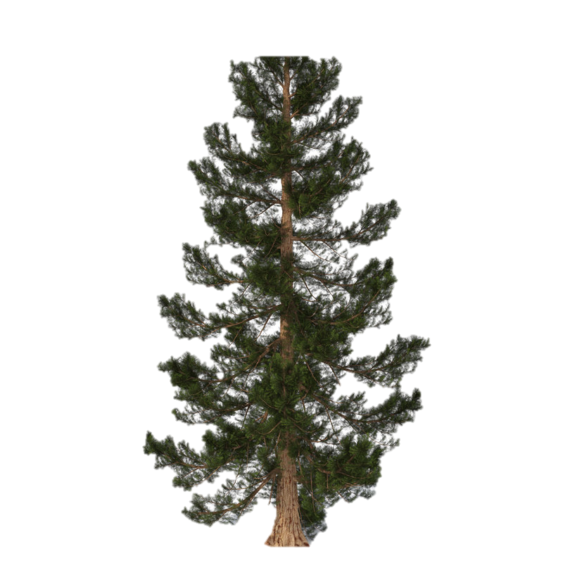
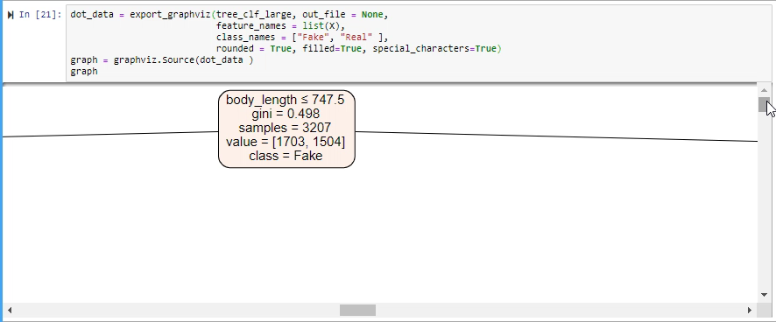
Large Tree
overfitting

Slide 21
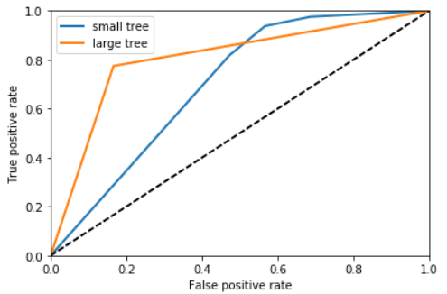
Scores
Small tree – Recall – 81.7%, precision – 59%, AUC Score – 0.7
Large tree – Recall – 77.4%, precision – 79%
AUC Score – 0.8

Slide 22
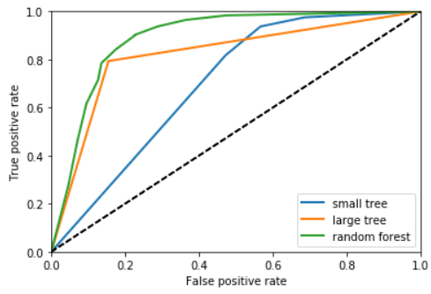
Random Forest
RF – Recall – 78%, Precision – 82%,
AUC score – 0.87

Slide 23
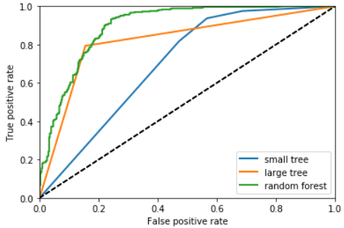
Grid Search Optimization
RF – Recall – 88.3%, Precision – 76.4%, AUC_Score = 0.88

Slide 24


Slide 25


Slide 26
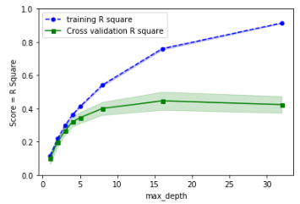
Max_Depth = 5

Slide 27
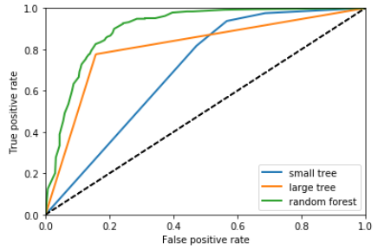
RF Correction
RF – Recall – 80.1%, Precision –82%, AUC_Score = 0.9

Slide 28
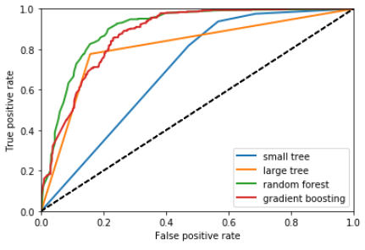
Gradient Boosting
RF – Recall – 83.5%, Precision – 76%,
AUC Score – 0.87

Slide 29


Slide 30

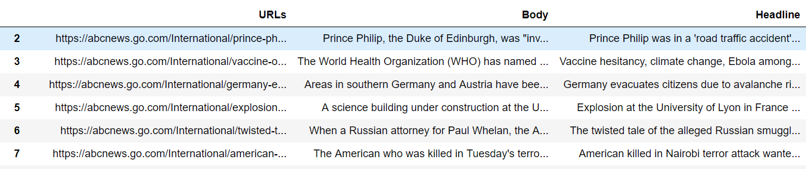
Newspaper3k: Article scraping & Curation
Headlines
Body
Authors
Publish Date
Site / URL
Category

Slide 31


Slide 32
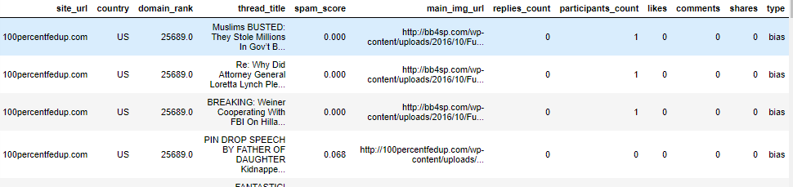
Fake
+
Biased

Slide 33


Slide 34

Thank You

